Slide 1


NATURAL LANGUGAGE PROCESSING:
EMOTION CLASSIFICATION
Raya-Neda, Petar, Vladislav, Mario
01
GROUP 24

Slide 2
Introduction
Client Value
Dataset
Feature Extraction
Implemented Models
Strengths & Weaknesses
Error Analysis
Annotations
Limitations
Next Steps & Recommendations
AGENDA
02

Slide 3
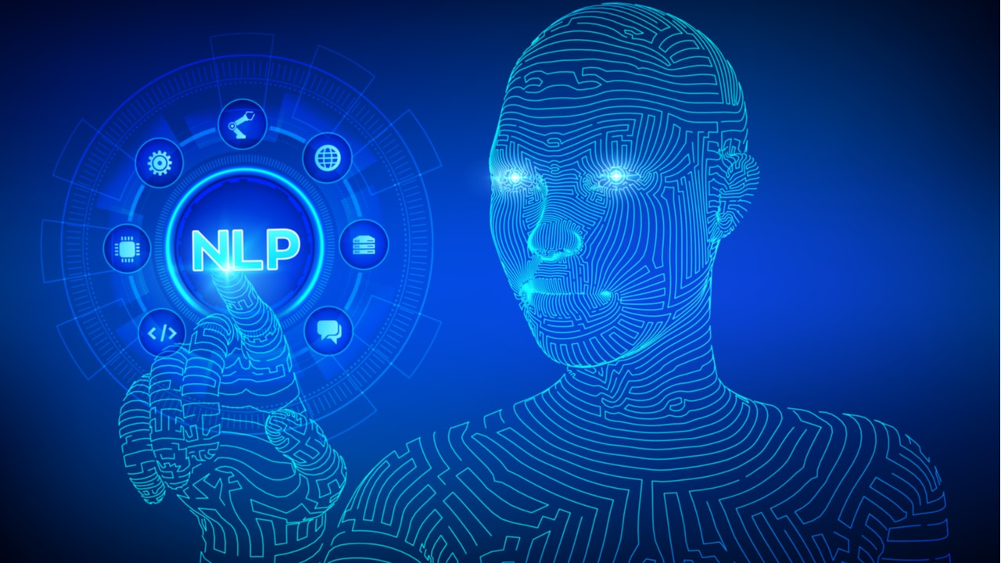
INTRODUCTION
Problem Definition
Emotion Classification in NLP
Use case
Identify emotions expressed in video content to support media creators
Client
CIA - They use AI to analyse every single detail of your film, series, TV-show or video
03

Slide 4

CLIENT VALUE
Time & Cost Savings
Automates emotional tagging;
Reduces human error in repetitive tasks.
Client Insights
& Output
Emotion Classification
Transcribtion & Translation
Video Input
04

Slide 5
PRE-PROCESSING
05

Slide 6
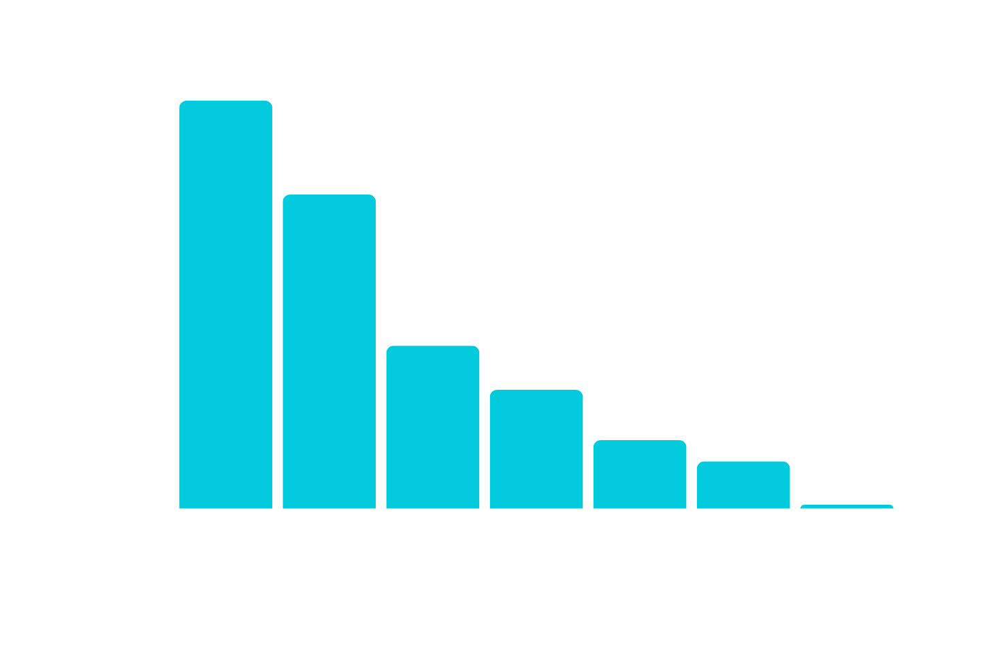
Used Datasets
MELD, GoEmotions, CAREER
DATASET
460K ROWS
06

Slide 7
FEATURE EXTRACTION
POS Tagging
CountVectorizer & TF-IDF
Sentiment Scores
Embeddings
07

Slide 8
IMPLEMENTED
MODELS
APPROACH | WEIGHTED F1-SCORE
Naive Bayes | 0.304
Logistic Regression | 0.332
RNN | 0.32
LSTM | 0.31
F1-Weighted
BERT Large
0.71
08

Slide 9
RESULTS
09

Slide 10
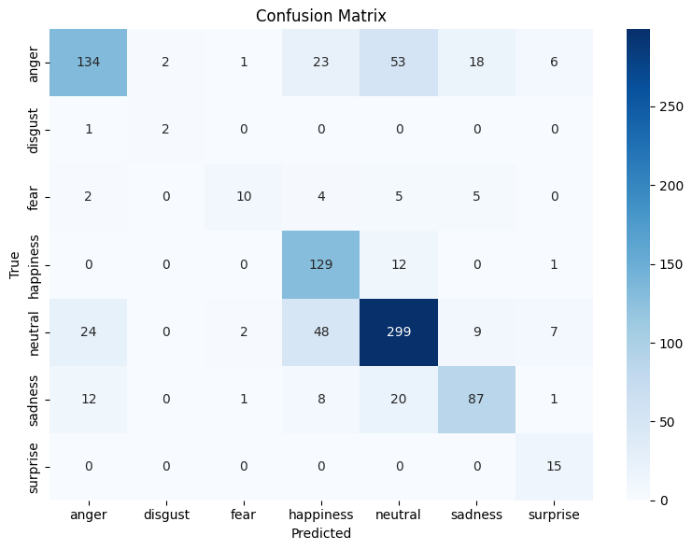
FINAL MODEL
STRENGHTS
High precision and recall for neutral and happiness
Anger is recognized well with some overlap with sadness and neutral
Few false positives for rare classes like disgust and surprise
Erros between anger, sadness, and neutral
Fear often confused with neutral and happiness
Poor performance on disgust and surprise
WEAKNESSES
10

Slide 11
emotions | precision | recall | f1-score
anger | 0.77 | 0.57 | 0.65
disgust | 0.5 | 0.67 | 0.57
fear | 0.71 | 0.38 | 0.5
happiness | 0.60 | 0.91 | 0.73
neutral | 0.77 | 0.77 | 0.77
sadness | 0.73 | 0.67 | 0.70
surprise | 0.5 | 1 | 0.67
macro avg | 0.66 | 0.71 | 0.66
weighted avg | 0.73 | 0.72 | 0.71
11

Slide 12
ERROR ANALYSIS
12

Slide 13
ERROR ANALYSIS
Label Issues
Emotional sentences mislabelled as ‘neutral’
Flat sentences labeled as ‘happiness’
Translation/Transcription Errors
Lost words & incomplete sentences
Unclear phrases due to poor transcription
CIA Test Set Fixes
Corrected many wrong labels & translations
Improved evaluation reliability
13

Slide 14







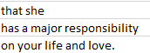


EXAMPLES
CIA: neutral Actual: happiness
CIA: happiness, Actual: neutral
CIA: happiness, Actual: neutral
CIA: neutral, Actual: sadness (nostalgia)
CIA: happiness, Actual: neutral
CIA: anger, Actual: sadness (incomplete sentence)
CIA: happiness, Actual: neutral
Incorrect Transcription (One sentence divided as 3 distinct)
Example of Incorrect Translation
14
Example of Incorrect Transcription

Slide 15
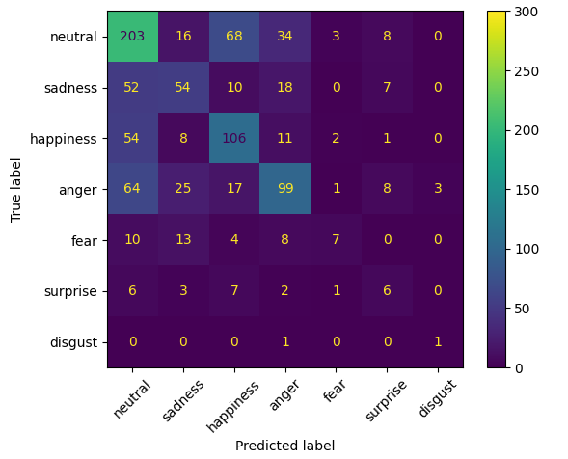
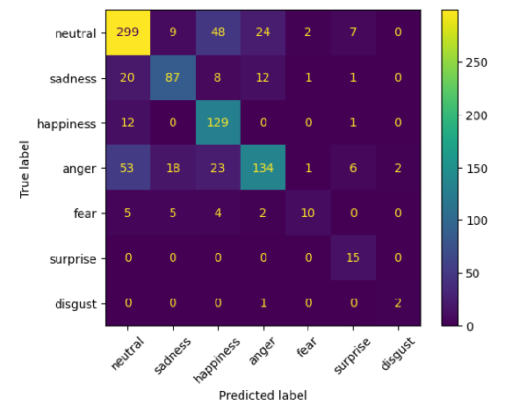

ANNOTATIONS
Before
F1-Weighted = 0.499
After
F1-Weighted = 0.714
15

Slide 16
LIMITATIONS
Data Imbalance
Incomplete transcription
Translation Errors
Context Loss in Text-only Analysis
16
Notes:
Data Imbalance - Few emotions are underrepresented;
Transcription & Translation Errors - Speech-to-text and translation tools can introduce mistakes;
Context Loss in Text-only Analysis - Sarcasm, irony, or subtle humor are difficult to detect without audio/visual context.

Slide 17
NEXT STEPS & RECOMMENDATIONS
Improve data quality
Collect more diverse training data
Implement the whole pipeline into an application
17

Slide 18


THANK YOU
FOR YOUR ATTENTION
Raya-Neda, Petar, Vladislav, Mario
Presented By: Olivia Wilson
18

